Slide 1
Classes

Slide 2
Class Fundamentals
It defines a new data type
Once defined, this new type can be used to create objects of that type
A class is a template for an object, and an object is an instance of a class

Slide 3
The General Form of a Class
  class classname {
  type instance-variable1;
  type instance-variable2;
  // ...
  type instance-variableN;
  type methodname1(parameter-list) {
  // body of method
  }
  type methodname2(parameter-list) {
  // body of method
  }
  // ...
  type methodnameN(parameter-list) {
  // body of method
  }
  }

Slide 4
Collectively, the methods and variables defined within a class are called members of the class
Variables defined within a class are called instance variables because each instance
of the class contains its own copy of these variables

Slide 5
A Simple Class
class Box {
double width;
double height;
double depth;
}
Box mybox = new Box();
// create a Box object called mybox

Slide 6
To access these variables, you will use the dot (.) operator
The dot operator links the name of the object with the name of an instance variable
Example:
mybox.width = 100;

Slide 7
class Box {
double width;
double height;
double depth;
}
// This class declares an object of type Box.
class BoxDemo {
public static void main(String args[]) {
Box mybox = new Box();
double vol;
// assign values to mybox's instance variables
mybox.width = 10;
mybox.height = 20;
mybox.depth = 15;
// compute volume of box
vol = mybox.width * mybox.height * mybox.depth;
System.out.println("Volume is " + vol);
}
}

Slide 8
When you compile this program, you will find that two .class files have been created, one for Box and one for BoxDemo
The Java compiler automatically puts each class into its own .class file

Slide 9
  class Box {
  double width;
  double height;
  double depth;
  }
  class BoxDemo2 {
  public static void main(String args[]) {
  Box mybox1 = new Box();
  Box mybox2 = new Box();
  double vol;
  // assign values to mybox1's instance variables
  mybox1.width = 10;
  mybox1.height = 20;
  mybox1.depth = 15;
  /* assign different values to mybox2's instance variables */
  mybox2.width = 3;
  mybox2.height = 6;
  mybox2.depth = 9;
  // compute volume of first box
  vol = mybox1.width * mybox1.height * mybox1.depth;
  System.out.println("Volume is " + vol);
  // compute volume of second box
  vol = mybox2.width * mybox2.height * mybox2.depth;
  System.out.println("Volume is " + vol);
  }
  }

Slide 10
Declaring Objects
First, you must declare a variable of the class type
This variable does not define an object ; Instead, it is simply a variable that can refer to an object
Second, you must acquire an actual, physical copy of the object and assign it to that variable. You can do this using the new operator

Slide 11
The new operator dynamically allocates memory for an object and returns a reference to it
Box mybox; // declare reference to object
mybox = new Box(); // allocate a Box object
OR
Box mybox = new Box();

Slide 12
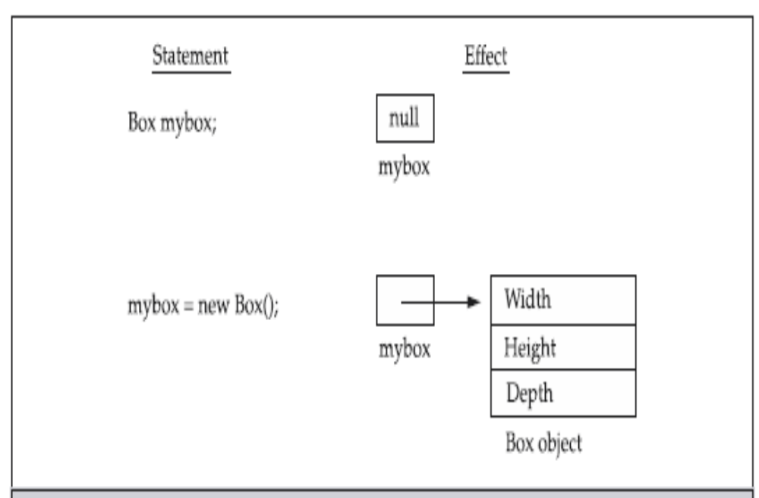

Slide 13
Assigning Object Reference Variables
Example:
  Box b1 = new Box();
  Box b2 = b1;
b1 and b2 will both refer to the same object
The assignment of b1 to b2 did not allocate any memory or copy any part of the original object
Any changes made to the object through b2 will affect the object to which b1 is referring, since they are the same object

Slide 14
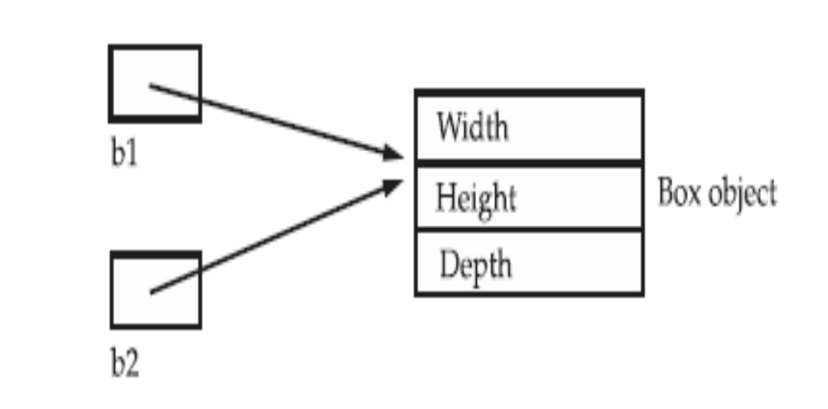

Slide 15
Although b1 and b2 both refer to the same object, they are not linked in any other way
Example:
  Box b1 = new Box();
  Box b2 = b1;
  // ...
  b1 = null;
Here, b1 has been set to null, but b2 still points to the original object

Slide 16
Note:
When you assign one object reference variable to another object reference variable, you are not creating a copy of the object, you are only making a copy of the reference

Slide 17
Introducing Methods
type name(parameter-list) {
// body of method
}
type specifies the type of data returned by the method
If the method does not return a value, its return type must be void
The parameter-list is a sequence of type and identifier pairs separated by commas

Slide 18
Return
return value;

Slide 19
class Box {
double width;
double height;
double depth;
// display volume of a box
void volume() {
System.out.print("Volume is ");
System.out.println(width * height * depth);
}
}
class BoxDemo3 {
public static void main(String args[]) {
Box mybox1 = new Box();
Box mybox2 = new Box();
// assign values to mybox1's instance variables
mybox1.width = 10;
mybox1.height = 20;
mybox1.depth = 15;
/* assign different values to mybox2's
instance variables */
mybox2.width = 3;
mybox2.height = 6;
mybox2.depth = 9;
// display volume of first box
mybox1.volume();
// display volume of second box
mybox2.volume();
}
}

Slide 20
class Box {
double width;
double height;
double depth;
// compute and return volume
double volume() {
return width * height * depth;
}
}
class BoxDemo4 {
public static void main(String args[]) {
Box mybox1 = new Box();
Box mybox2 = new Box();
double vol;
// assign values to mybox1's instance variables
mybox1.width = 10;
mybox1.height = 20;
mybox1.depth = 15;
/* assign different values to mybox2's instance variables */
mybox2.width = 3;
mybox2.height = 6;
mybox2.depth = 9;
// get volume of first box
vol = mybox1.volume();
System.out.println("Volume is " + vol);
// get volume of second box
vol = mybox2.volume();
System.out.println("Volume is " + vol);
}
}

Slide 21
class Box {
double width;
double height;
double depth;
// compute and return volume
double volume() {
return width * height * depth;
}
// sets dimensions of box
void setDim(double w, double h, double d) {
width = w;
height = h;
depth = d;
}
}
class BoxDemo5 {
public static void main(String args[]) {
Box mybox1 = new Box();
Box mybox2 = new Box();
double vol;
// initialize each box
mybox1.setDim(10, 20, 15);
mybox2.setDim(3, 6, 9);
// get volume of first box
vol = mybox1.volume();
System.out.println("Volume is " + vol);
// get volume of second box
vol = mybox2.volume();
System.out.println("Volume is " + vol);
}
}

Slide 22
Constructors
A constructor initializes an object immediately upon creation
It has the same name as the class in which it resides and is syntactically similar to a method
Have no return type, not even void

Slide 23
class Box {
double width;
double height;
double depth;
// This is the constructor for Box.
Box() {
System.out.println("Constructing Box");
width = 10;
height = 10;
depth = 10;
}
// compute and return volume
double volume() {
return width * height * depth;
}
}
class BoxDemo6 {
public static void main(String args[]) {
// declare, allocate, and initialize Box objects
Box mybox1 = new Box();
Box mybox2 = new Box();
double vol;
// get volume of first box
vol = mybox1.volume();
System.out.println("Volume is " + vol);
// get volume of second box
vol = mybox2.volume();
System.out.println("Volume is " + vol);
}
}

Slide 24
Consider
Box mybox1 = new Box();
new Box( ) is calling the Box( ) constructor
When you do not explicitly define a constructor for a class, then Java creates a default constructor for the class
The default constructor automatically initializes all instance variables to zero

Slide 25
Parameterized Constructors
class Box {
double width;
double height;
double depth;
// This is the constructor for Box.
Box(double w, double h, double d) {
width = w;
height = h;
depth = d;
}
// compute and return volume
double volume() {
return width * height * depth;
}
}

Slide 26
class BoxDemo7 {
public static void main(String args[]) {
// declare, allocate, and initialize Box objects
Box mybox1 = new Box(10, 20, 15);
Box mybox2 = new Box(3, 6, 9);
double vol;
// get volume of first box
vol = mybox1.volume();
System.out.println("Volume is " + vol);
// get volume of second box
vol = mybox2.volume();
System.out.println("Volume is " + vol);
}
}

Slide 27
The this Keyword
this can be used inside any method to refer to the current object
this is always a reference to the object on which the method was invoked
Example:
Box(double w, double h, double d) {
this.width = w;
this.height = h;
this.depth = d;
}

Slide 28
// Use this to resolve name-space collisions.
Box(double width, double height, double depth) {
this.width = width;
this.height = height;
this.depth = depth;
}

Slide 29
Garbage Collection
In some languages, such as C++, dynamically allocated objects must be manually released by use of a delete operator
Java takes a different approach; it handles deallocation for you automatically
The technique that accomplishes this is called garbage collection

Slide 30
Contd..
When no references to an object exist, that object is assumed to be no longer needed, and the memory occupied by the object can be reclaimed
There is no explicit need to destroy objects as in C++

Slide 31
The finalize( ) Method
Sometimes an object will need to perform some action when it is destroyed
For example, if an object is holding some non-Java resource such as a file handle or window character font, then you might want to make sure these resources are freed before an object is destroyed

Slide 32
By using finalization, you can define specific actions that will occur when an object is just about to be reclaimed by the garbage collector
To add a finalizer to a class, you simply define the finalize( ) method
Inside the finalize( ) method you will specify those actions that must be performed before an object is destroyed

Slide 33
The finalize( ) method has this general form:
protected void finalize( )
{
// finalization code here
}
The keyword protected is a specifier that prevents access to finalize( ) by code defined outside its class

Slide 34
It is important to understand that finalize( ) is only called just prior to garbage collection
It is not called when an object goes out-of-scope, for example
This means that you cannot know when—or even if—finalize( ) will be executed
Therefore, your program should provide other means of releasing system resources, etc., used by the object

Slide 35
Example: A Stack Class
class Stack {
int stck[] = new int[10];
int tos;
// Initialize top-of-stack
Stack() {
tos = -1;
}
// Push an item onto the stack
void push(int item) {
if(tos==9)
System.out.println("Stack is full.");
else
stck[++tos] = item;
}
// Pop an item from the stack
int pop() {
if(tos < 0) {
System.out.println("Stack underflow.");
return 0;
}
else
return stck[tos--];
}
}

Slide 36
class TestStack {
public static void main(String args[]) {
Stack mystack1 = new Stack();
Stack mystack2 = new Stack();
// push some numbers onto the stack
for(int i=0; i<10; i++) mystack1.push(i);
for(int i=10; i<20; i++) mystack2.push(i);
// pop those numbers off the stack
System.out.println("Stack in mystack1:");
for(int i=0; i<10; i++)
System.out.println(mystack1.pop());
System.out.println("Stack in mystack2:");
for(int i=0; i<10; i++)
System.out.println(mystack2.pop());
}
}

